Slide 3
REGISTRATION AND TURNOUT TRENDS
(2020-2024)

Slide 4
VOTER REGISTRATION CHANGES 2020-2024
The Dem share of registered voters dropped in 4 of 4 states
The Unaffiliated share increased in all 4 states
The GOP share outperformed Dems in all 4 states

Slide 5
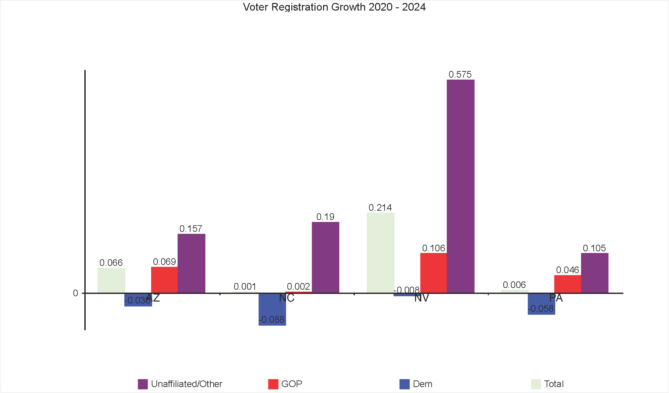

Slide 6
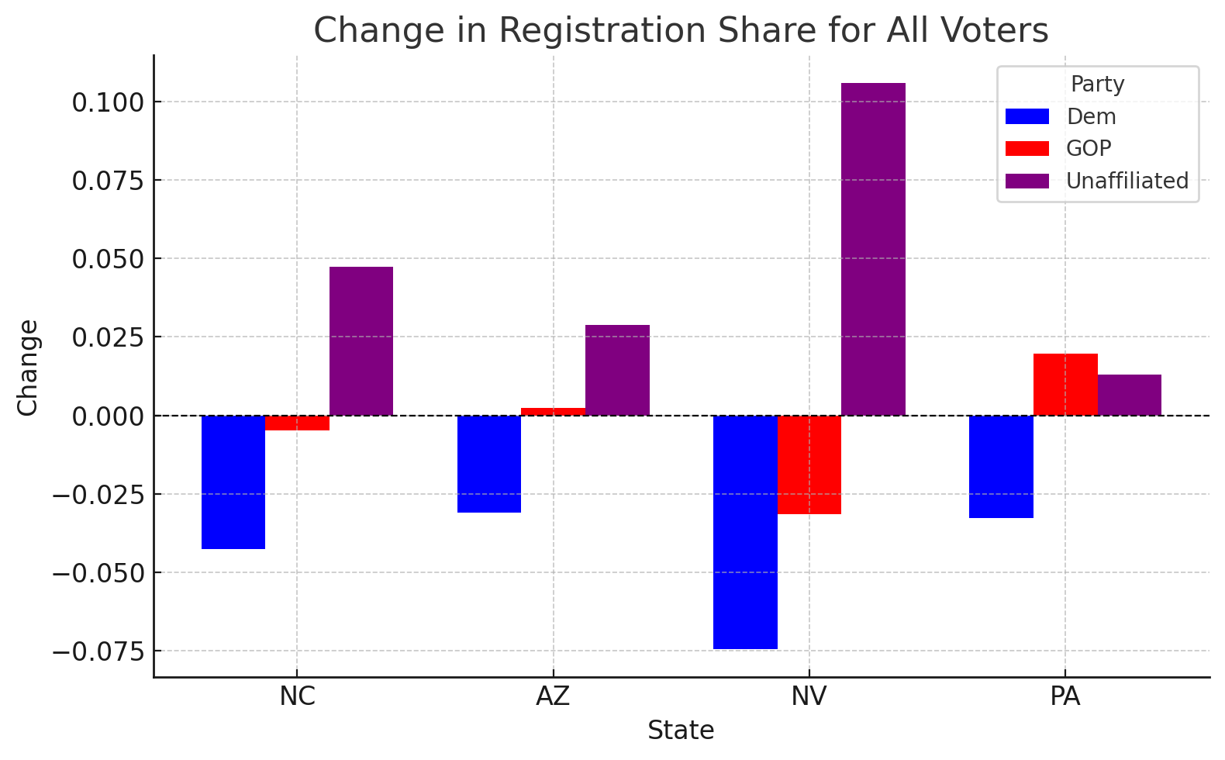

Slide 7
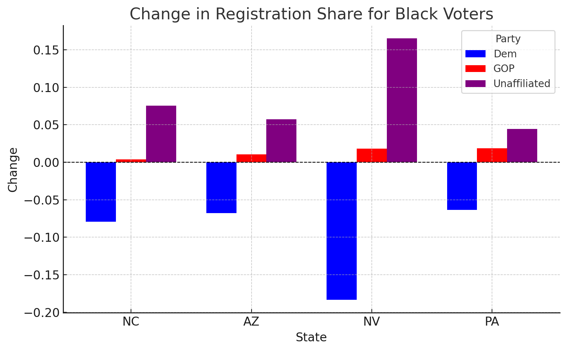

Slide 8
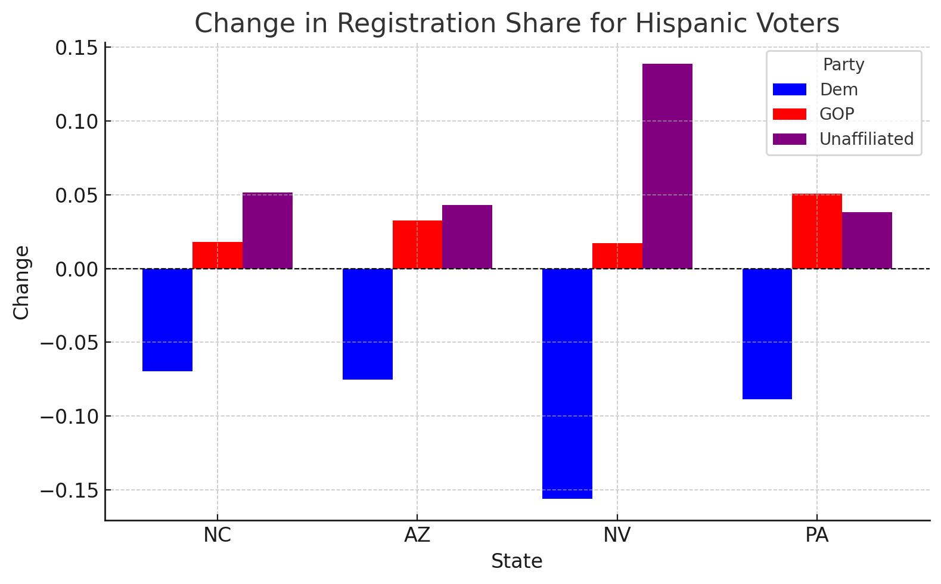

Slide 9
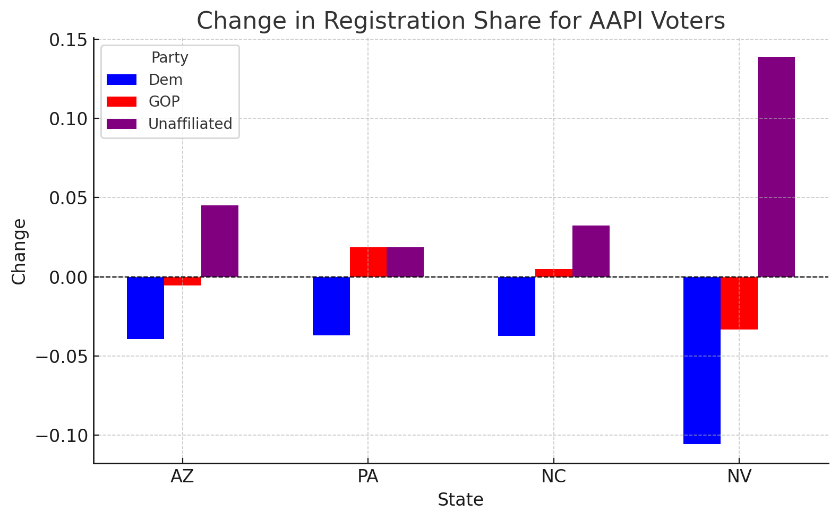

Slide 10
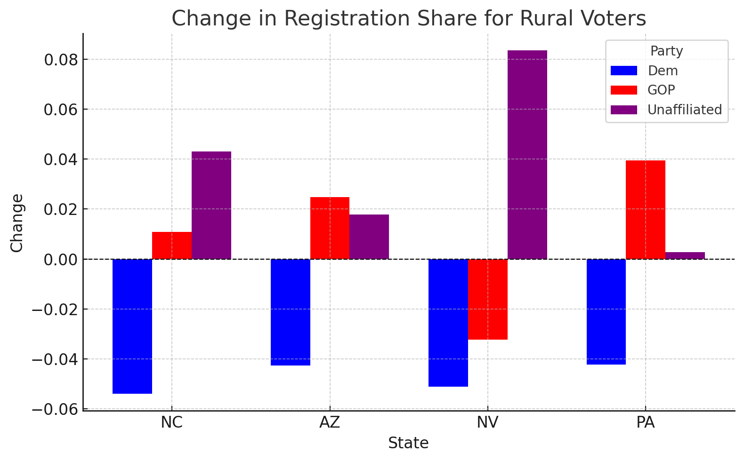

Slide 11
VOTER TURNOUT CHANGES 2020-2024
Turnout as a percent of registration dropped in 3 of 4 states, across party lines
Dem turnout dropped by more than GOP turnout in 3 of 4 states, but the difference was <1% in every state but AZ

Slide 12
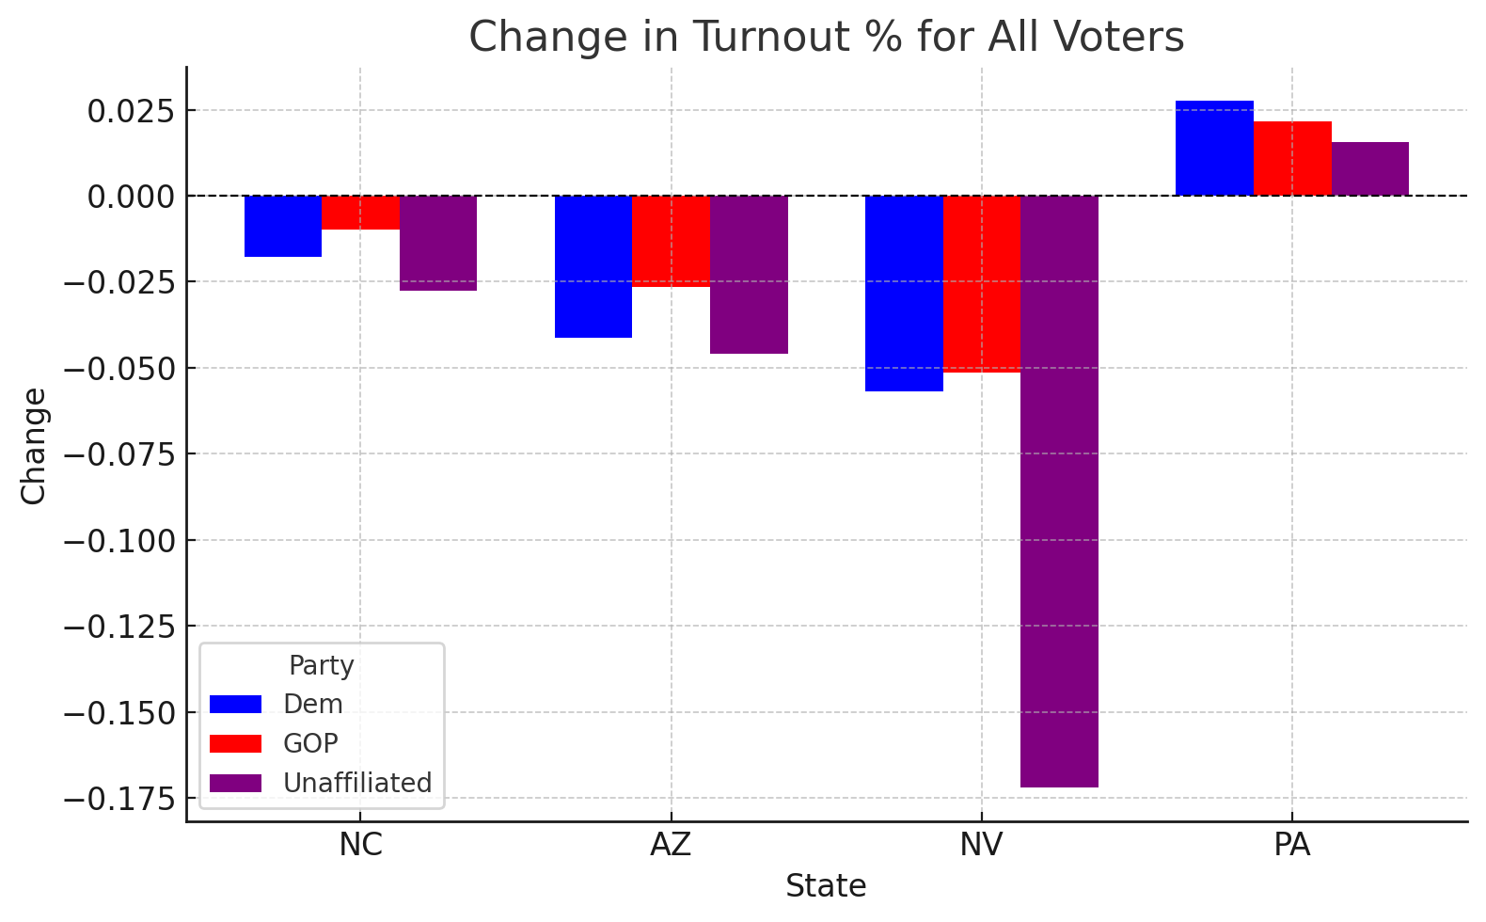

Slide 13
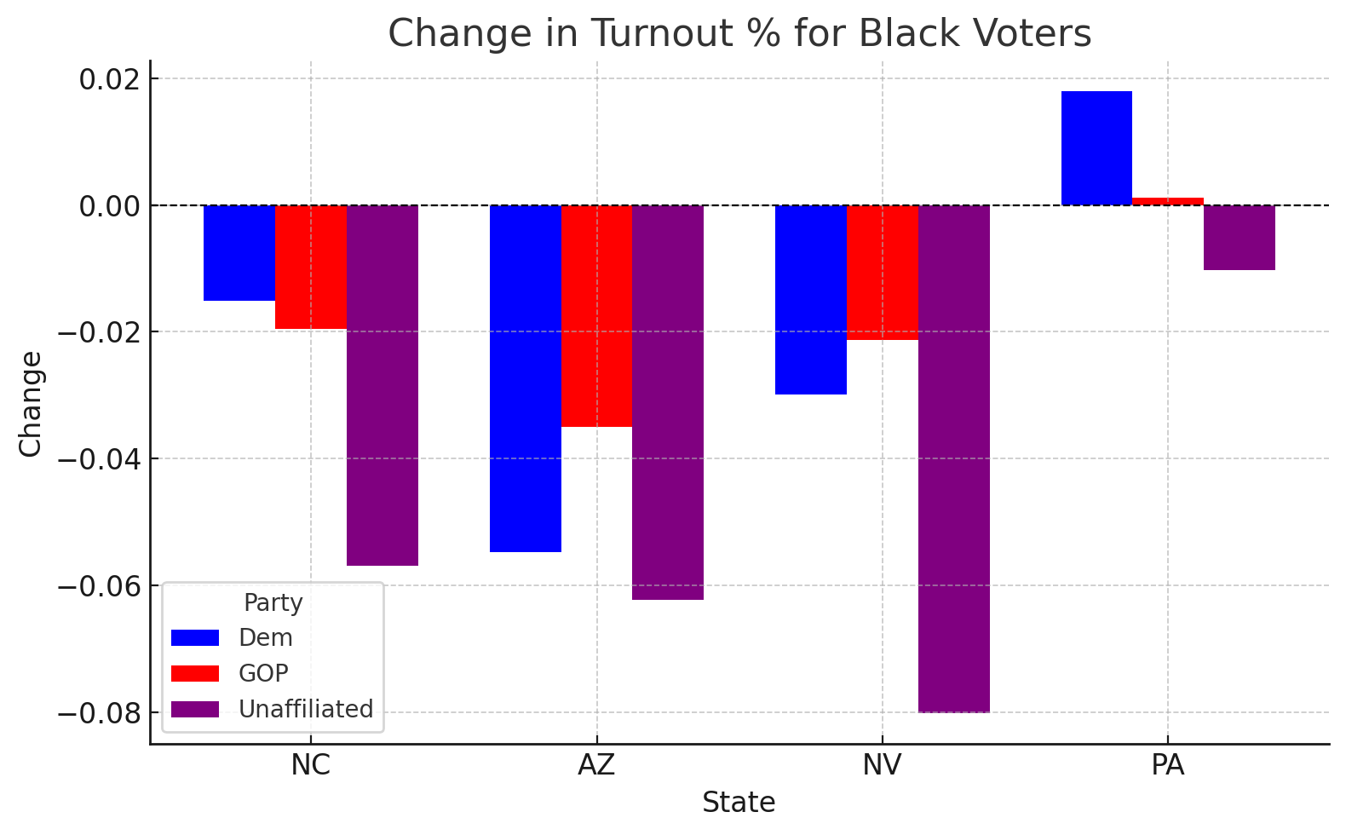

Slide 14
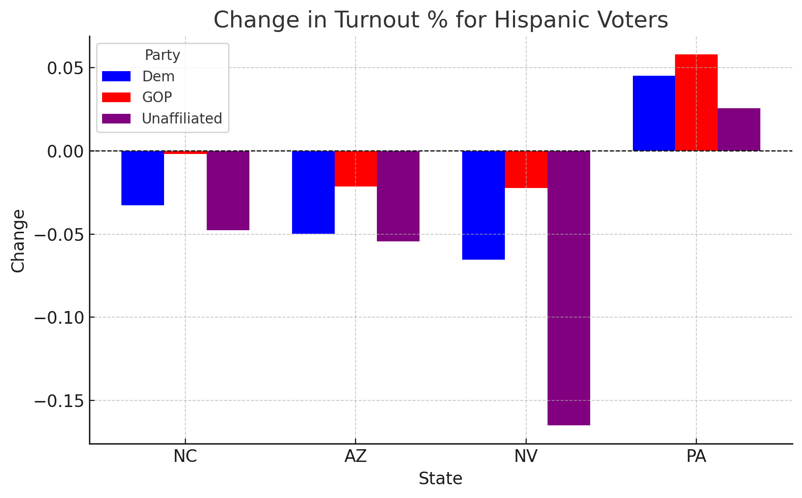

Slide 15
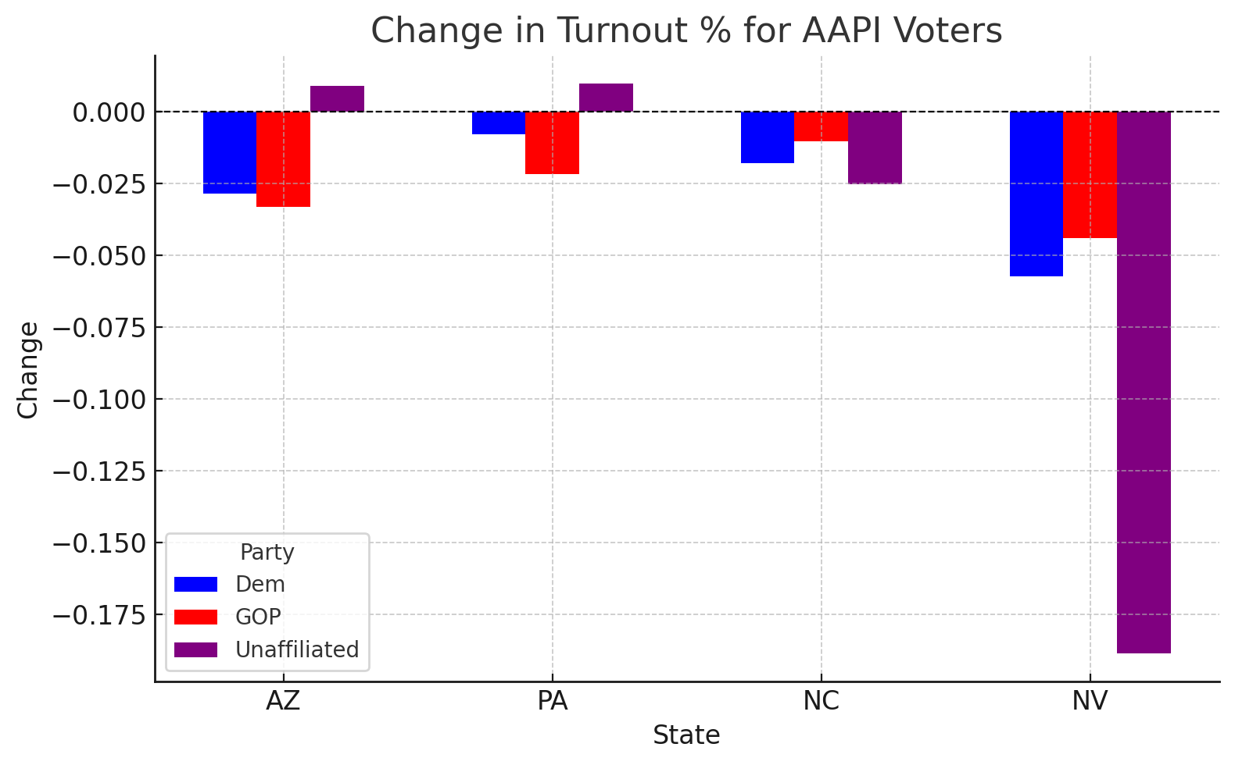

Slide 16
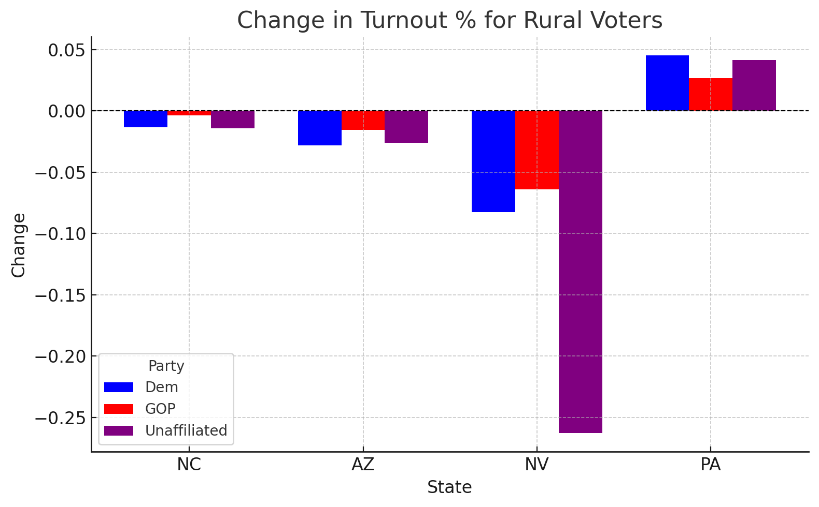

Slide 17
ELECTORATE SHARE CHANGES 2020-2024
The biggest increases in electorate share came from unaffiliated voters in 3 of 4 states
The biggest drops in electorate share came from Dems in 4 of 4 states
The changes in electorate share closely mirrored the changes in registration share

Slide 18
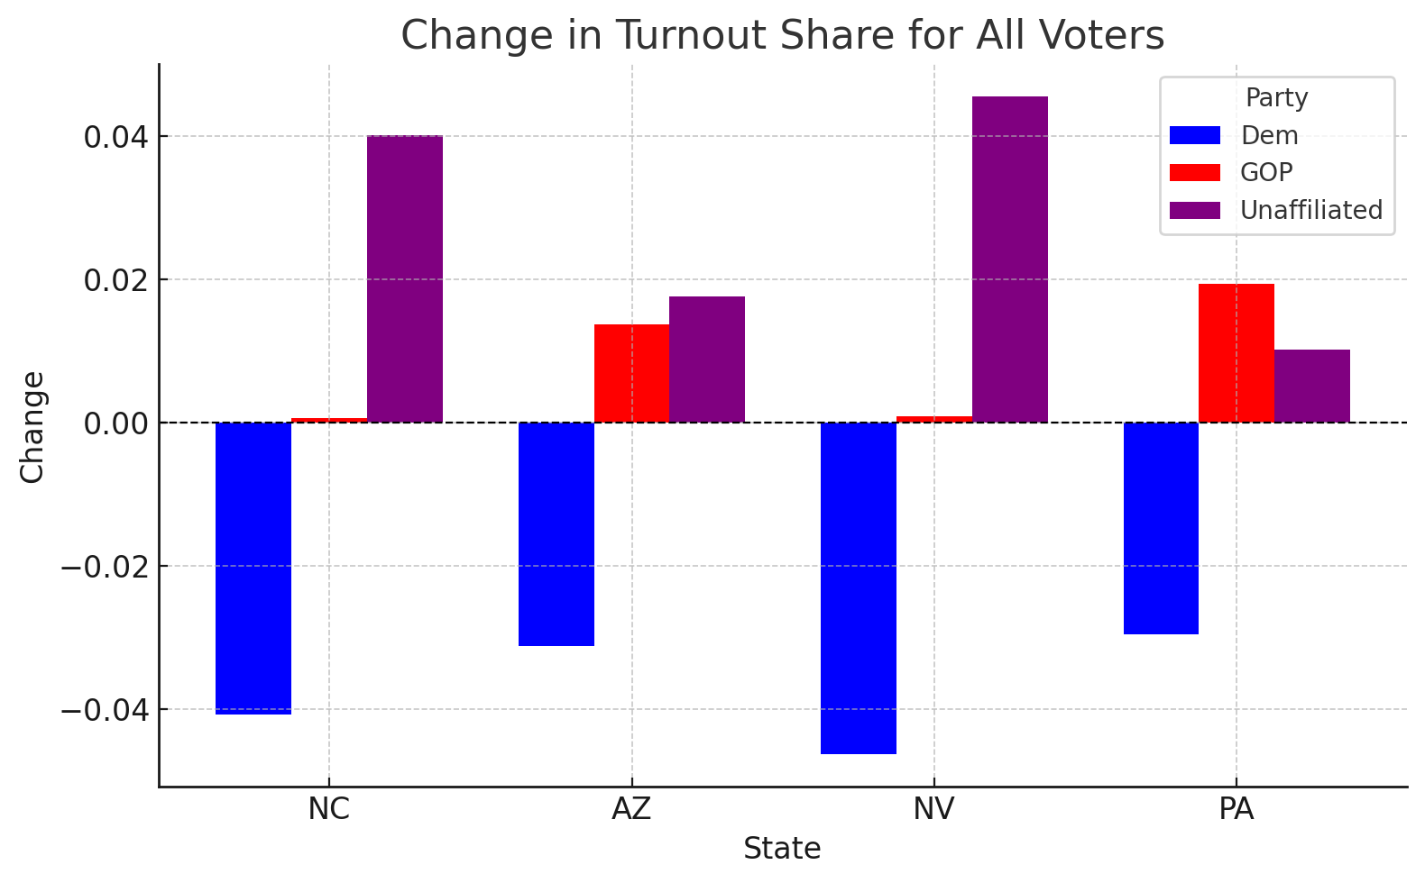

Slide 19
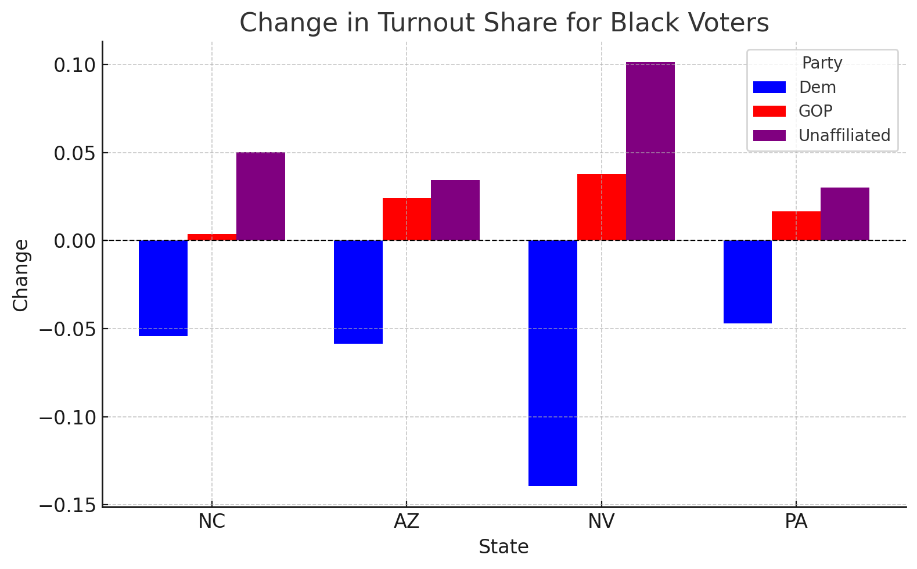

Slide 20
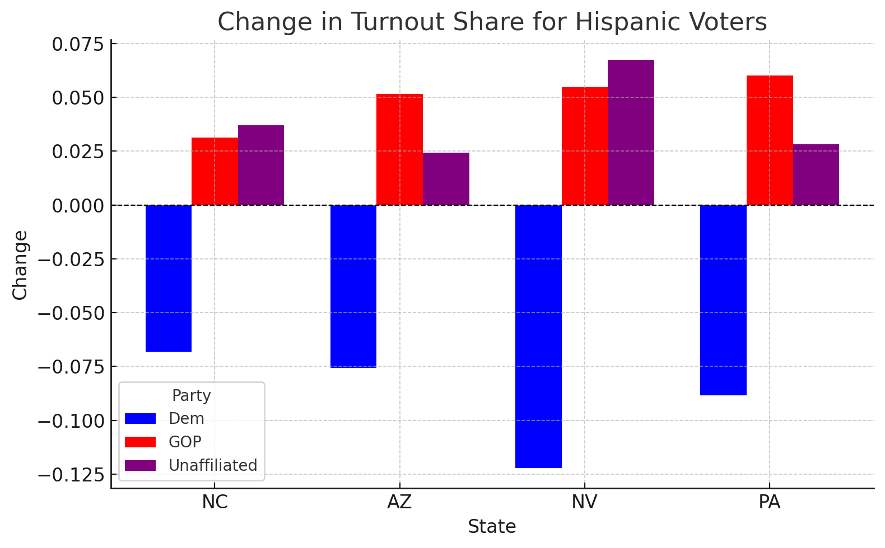

Slide 21
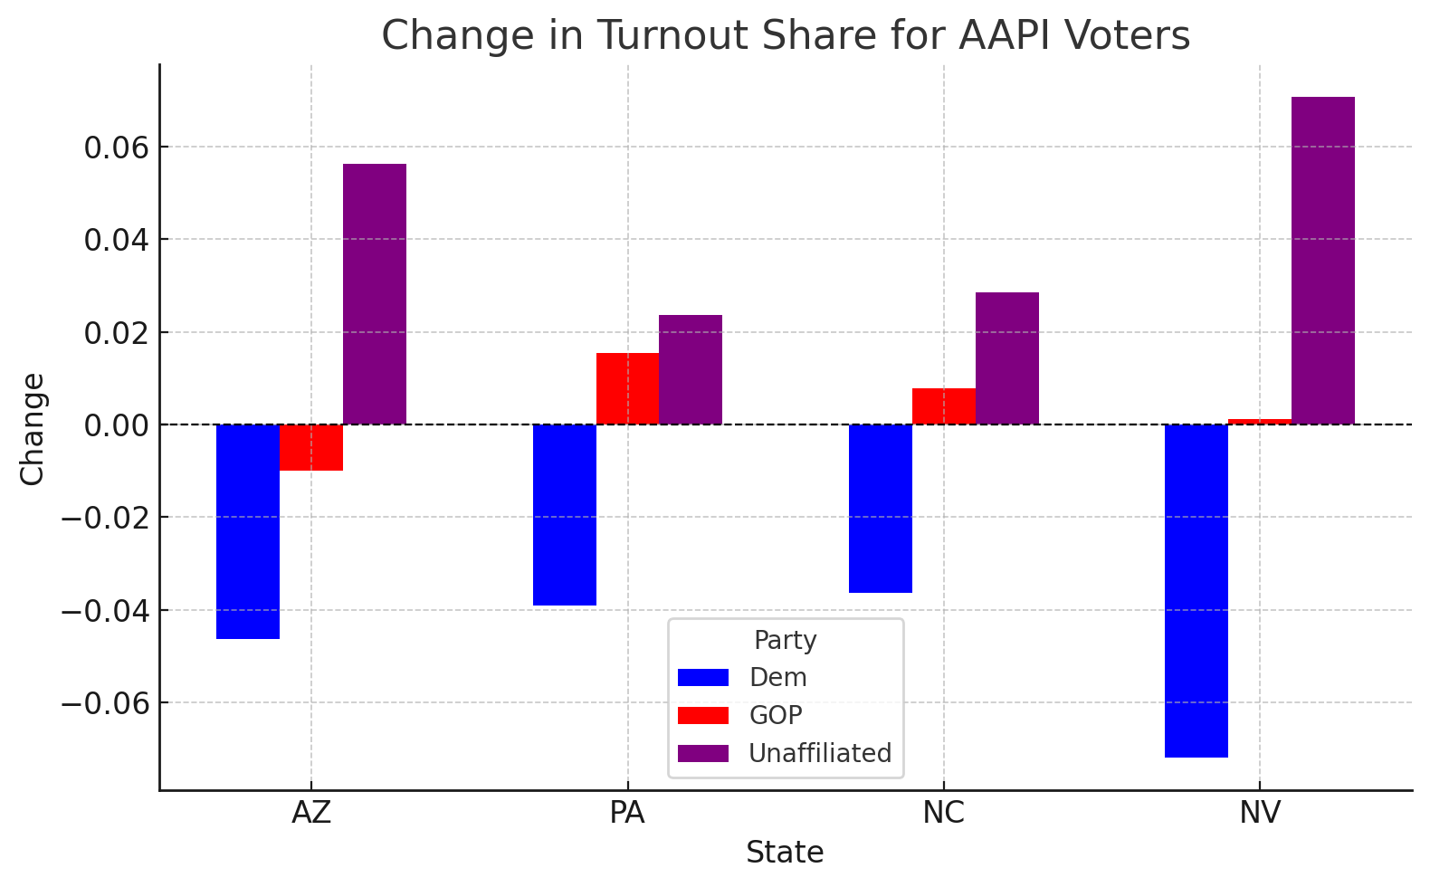

Slide 22
